Slide 1
GIT – Version Control System
Part – 2 GIT Branching
S. Yogesh Kumar
sykumar@tricoresolutions.com
Middleware Services – TriCore Solutions

Slide 2
Agenda
GIT Objects
GIT Branching Concept
Scenario – Basic Branching and Merging
Merge Conflict
Branch Management
Branch Workflows
Remote Branches
Rebase

Slide 3
GIT Object
GIT is a content addressable system.
There are basically four types of objects in GIT.
BLOB : Refers to the content of each files
Tree : Refers to the directory at a specific point
Commit : Refers to a master tree at a specific point
Tag: Refers to a specific commit
Working Directory
k7hf5e
ee2cf9
Readme file
99e2cf
commit
tree ee2cf9
author Yogesh
committer Yogesh
tree
blob 99e2cf
blob c2fe4e
License file
c2fe4e
tag
object k7hf5e
type commit
tag v1.0
tagger Yogesh
My first 1.4 version
ds3twe

Slide 4
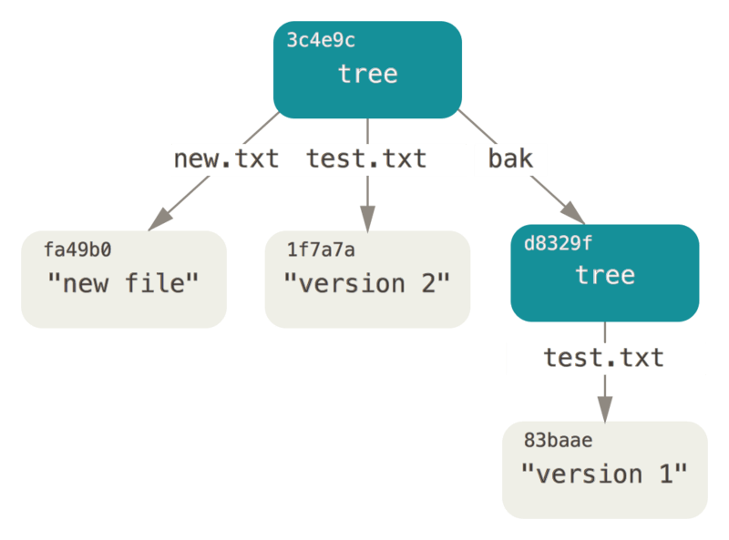
GIT Objects
To get the SHA-1 checksum for any file stored in the git repository use the below command
$ git hash-object –w [file-name]
The SHA-1 checksum can be used any time to look into the content and to revert back changes. To revert back the content use the below command.
$ git cat-file –p [Checksum for content to be reverted] > [file-name]
Tree Object
To see the status of a current tree use the below command
$ git cat-file –p master^{tree}

Slide 5
GIT Objects
Commit Object: Commit object basically stores the below information
Tree: This refers to the master tree directory
Parent: This refers to the previous commit object. In initial commit parent is not present
Author: This refers to the person who created the tree
Committer: This refers to the person who commits the changes to the GIT repository
e2aah8
54erv2
er6ds9
Readme.txt
License.txt
Readme.txt
License.txt
Version1.txt
Readme.txt
License.txt
Version1.txt
Version2.txt
Working Directory
tree e2aah8
parent
yogesh
yogesh
tree 54erv2
parent uk9ret
yogesh
yogesh
tree er6ds9
parent swe4nb
yogesh
yogesh
Commit snapshots
uk9ret
swe4nb
pokje1

Slide 6
GIT Branching Concept
Branching means you diverge from the main line of development and continue to do work without messing with that main line.
Now lets create a branch using command: $ git branch [branch-name]
To track the current branch that you are working on GIT uses HEAD pointer. HEAD always point to the latest commit in the branch. Use command $ git log --oneline --decorate to see the HEAD pointer
master
C0
C1
C2
master
C0
C1
C2
test

Slide 7
GIT Branching Concept
By default master branch is created when you initialize git repository. So HEAD will point to the latest commit in master branch.
If you want to work in new Test branch, you have to switch from master branch. Use command to switch between branches: $ git checkout [branch-name] #The mentioned branch will be you active branch
HEAD
master
C0
C1
C2
test

Slide 8
GIT Branching Concept
Now the HEAD will point to Test branch.
Suppose you do a change in test branch and performed a commit.
master
C0
C1
C2
test
HEAD
master
C0
C1
C2
C3
test
HEAD

Slide 9
GIT Branching Concept
Let’s switch back to the master branch.
Now switch command will do two things.
It moves the HEAD pointer back to point to the master branch, and
it reverts the files in your working directory back to the snapshot that master points to.
HEAD
master
C0
C1
C2
C3
test

Slide 10
Scenario – Basic Branching and Merging
Consider an example with below workflow:
You developed a project and it is running in production environment
Create a branch to fix Issues that are listed in issue trak.
Do some work in that branch.
At this stage, you’ll receive a call that another issue is critical and you need a hotfix. You’ll do the following:
Switch to your production branch.
Create a branch to add the hotfix.
After it’s tested, merge the hotfix branch, and push to production.
Switch back to your issue and continue working.

Slide 11
Scenario – Basic Branching and Merging
Lets say your working production project has several commits.
Create a branch for Issue# 25: $ git branch issue25 and switch to it for working by using command: $ git checkout issue25
You work on issue25 and do commits.
master
C0
C1
C2
master
C0
C1
C2
issue25
master
C0
C1
C2
C3
issue25

Slide 12
Scenario – Basic Branching and Merging
Now you got a call and you have to work on hotfix. Commit your issue25 branch and switch back to master: $ git checkout master and create a new branch hotfix and switch to it to work for hotfix $ git branch hotfix
After you have tested your hotfix you can merge the fix with your master branch. Use below command:
$ git checkout master
$ git merge hotfix
master
hotfix
C0
C1
C2
C4
C3
issue25

Slide 13
Scenario – Basic Branching and Merging
At this point your master branch and hotfix will be pointing to the same commit.
Now you can delete you hotfix branch as master is also pointing to the same commit. To delete a branch use command $ git branch –d hotfix
You are now ready to work on your issue25. So switch to your issue25 branch. Do some work and perform commit to save your changes on issue25.
master
hotfix
C0
C1
C2
C4
C3
issue25

Slide 14
Scenario – Basic Branching and Merging
Your repository will look some thing like this.
Now your work on issue25 is complete and you want to merge the changes to your master branch. Use below steps:
$ git checkout master
$ git merge issue25
master
C0
C1
C2
C4
C3
C5
issue25

Slide 15
Scenario – Basic Branching and Merging
In this case, GIT uses three way merge commit in which a commit object is created which combines the changes of the two commits from different branches.
Merging Techniques:
Fast Forward: Used when the branch you are merging has the direct ancestor from the branch you are merging into
Three way merge: When the branch you are merging do not have a direct ancestor. The new commit object created is known as merge commit.
master
C0
C1
C2
C4
C6
C3
C5
issue25

Slide 16
Merge Conflict
Conflict occurs when you changed the same part of the same file differently in two branches you are merging together.
Steps to resolve the conflict:
Open a file in which conflict occurs.
Choose what changes you need to keep in a file.
Add the file to staging area.
Perform commit operation

Slide 17
Branch Management
We can use git branch command for multiple purpose:
$ git branch #This command lists all the branches present in your repository.
$ git branch –v #This command will list all the branches along with the last commit on each branch
$ git branch --merged #This command list all the branches that have been merged.
$ git branch --no-merged # This command will list the branches that have not been merged.
$ git branch –d [branch-name] #This command will delete the mentioned branch

Slide 18
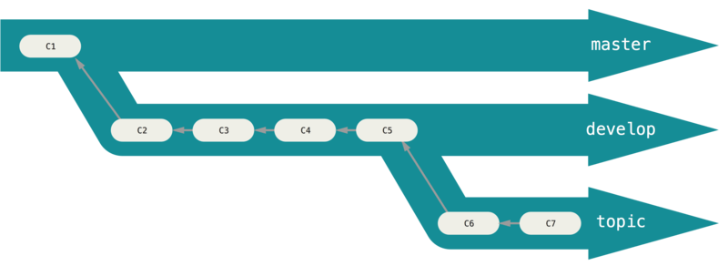
Branch Workflows
Branch within git can be categorised into two
Long Running Branches: These branches are always open and used for different stages of development cycle. These are merged into master as per the requirement and testing.
Topic branches: These are short living branches and are merged back into your master branch after completion

Slide 19
Remote Branches
Remote references are the pointers in your remote repositories, including branches, tags and etc.
Use $ git ls-remote [remote-name] to get the list of remote references.
Remote Tracking branches:
These are references to the state of remote branches. They are local reference that you can’t move.
These branches acts as bookmarks to remind you where the branches in your remote repositories were the last time you connected to them.
They take the form (remote)/(branch). E.g.: origin/master
Suppose you have remote repository on our server git.middleware.com
Remote server
master
ob7e4
5huk9
3febh

Slide 20
Remote Branches
When you clone this repository on your machine:
This will create a pointer to where its master branch is, and name it origin/master
Local master branch starting at the same place as origin’s master on which you can work on.
Local computer
origin/master
ob7e4
5huk9
3febh
master

Slide 21
Remote Branches
You do work and perform commits on your system. This will move your local master forward.
Now let us say that someone has worked and pushed their changes to the remote repository. This will make the remote master branch move forward in remote server.
Local computer
origin/master
ob7e4
5huk9
3febh
sde4t
sde4t
master
Remote server
master
ob7e4
5huk9
3febh
eds23
7yfr8

Slide 22
Remote Branches
If you try to push your changes, you will get error because there were some files or work on the remote server that you don’t have.
So first downloads the work your don’t have on your local machine using below commands:
$ git fetch origin # This command will fetch all the data but did not merge into your local master
$ git pull origin #This command will downloads data and merge into your local master
After you fetch the data you don’t have.
Local computer
origin/master
Changes from 2nd Developer
eds23
7yfr8
ob7e4
5huk9
3febh
sde4t
sde4t
Changes from your branch
master

Slide 23
Remote Branches
When you merge your data with the data you have fetched. Git creates a merge commit that contain changes from both developer.
Local computers
origin/master
Changes from 2nd Developer
eds23
7yfr8
Merge Commit
ob7e4
5huk9
3febh
6ghbv
sde4t
sde4t
master
Changes from your branch

Slide 24
Remote Branches
Finally you push your changes to the remote server so that it can be used by any other members. After your push operation your remote reference will shift and both local and remote repositories are in synch with the lasts changes.
Remote server
Changes from 2nd Developer
eds23
7yfr8
Origin/master
ob7e4
5huk9
3febh
6ghbv
sde4t
sde4t
Changes from your branch

Slide 25
Remote Branches
Pushing a Branch
$ git push [remote-name] [branch-name]
Pulling a Branch
$ git pull [branch-name]
Deleting a Branch
$ git push [remote-name] --delete [branch-name]
Tracking Branch
$ git checkout --track [remote-name]/[branch-name]

Slide 26
Rebasing
There are two main ways to integrate changes from one branch into another:
Merge
Rebase
The basic rebase:
master
C0
C1
C2
C3
test

Slide 27
Rebasing
With the rebase command you can take all the changes that were committed on one branch and replay them on another one.
$ git rebase master
At this point, you can go back to the master branch and do a fast-forward merge.
$ git checkout master
$ git merge test
master
C0
C1
C2
C3’
test
master
C0
C1
C2
C3’
test

Slide 28
Thank you!

